Slide 1
USING SOCIAL MEDIA IN BUSINESS
Summer 2023

Slide 2
Scenario
The local council has a department that looks at local businesses in Biggin Hill, Bromley. The department are interested in how they can support local businesses to use social media to promote their businesses, but they know very little about this. The department has approached Charles Darwin School, as they know the sixth form students are studying a unit on social media in business.
You have been asked as part of your Summer Bridging Work to provide a presentation on using social media for business purposes to present this to the department and your teacher when you return in September.

Slide 3
Task Instructions
Create a presentation to deliver in class when you return in September in which you provide an evaluation of the different ways in which a business can use social media.
You should cover how social media can be used to interact with customers and promote business products and/or services.
You should also cover ways in which social media can be used to target a specific audience and the audience profiles of different social media sites.

Slide 4
Introduction
“In this presentation I will be talking to you about……”
Make sure your introduction states clearly what you will be speaking about. You may even say why
Decide on a font size and keep it consistent throughout
If you use an image, make sure it is carefully placed edited and relevant

Slide 5
Social media websites
“A social media web site is…….”
“Examples of social media sites are….”

Slide 6
Social media websites
“Developments in social media affect the way businesses promote products and services……these include:
social media websites are constantly evolving and new features are introduced regularly
The use of features, structure and target audience of different social media websites, e.g. FacebookTM, Twitter™, LinkedIn®, GoogleTM + and YouTubeTM.…”

Slide 7
Social media websites
Social media websites are constantly evolving and new features are introduced regularly
Notes:
Social media websites are constantly evolving and new features are introduced regularly e.g. recent changes on ………….. Include………... this means that businesses can now ………… This is good because……..
Another example of a change is ……….
Etc……….

Slide 8
Social media websites
The use of features, structure and target audience of different social media websites can be used by businesses to …… e.g. FacebookTM, Twitter™, LinkedIn®, GoogleTM + and YouTubeTM.…”
Notes:
Social media sites have different features, structures and target audiences.
The next slides will look at these in more detail and explain how a business could make use of them

Slide 9
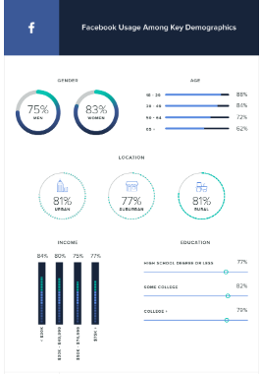
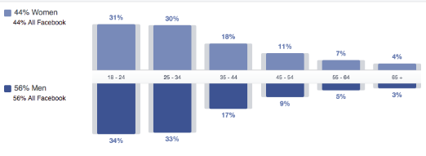
Social media websites - Features
Bullet points about the demographics
Notes:
More detail about the demographics AND what a business could do to use this information

Slide 10
Social media websites - Features
Twitter
Screen shot
Bullet points about the demographics
Notes:
More detail about the demographics AND what a business could do to use this information

Slide 11
Social media websites - Features
Pinterest
Screen shot
Bullet points about the demographics
Notes:
More detail about the demographics AND what a business could do to use this information

Slide 12
Social media websites - Features
Instagram
Screen shot
Bullet points about the demographics
Notes:
More detail about the demographics AND what a business could do to use this information

Slide 13
Social media websites - Features
LinkedIn
Screen shot
Bullet points about the demographics
Notes:
More detail about the demographics AND what a business could do to use this information

Slide 14
Social media websites: Structure & Features
The use of features, structure and target audience of different social media websites,
For Twitter these include:
Profile
Tweets
Polls
Re-tweets
Pinned Tweets
Direct messages
Twitter moments
Following
Notes:
The social media sites have different structures and features that a business can use the first site I will look at is twitter. There are many features that a business can use, they include the following, some of which I will demonstrate…
https://www.lilachbullock.com/twitter-features/

Slide 15
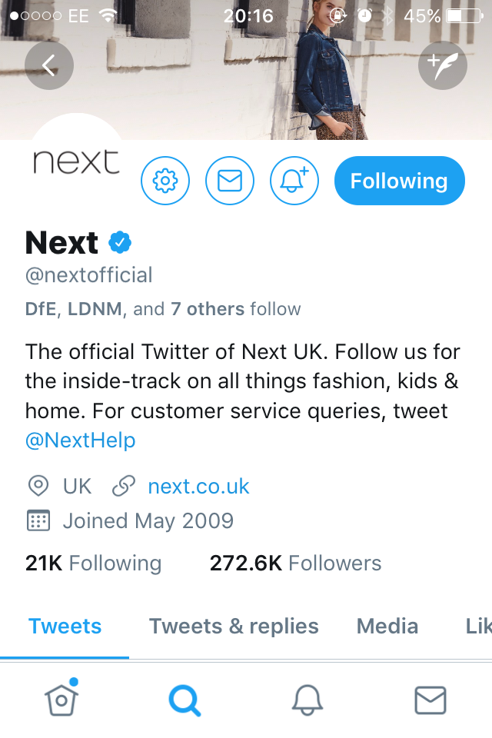
Social media websites: Structure & Features
Bullet points about the Twitter profile
Notes:
Twitter enables you to create a profile page which means a business can……………..
A profile page is important because….
The examples shown are good because….[M1]

Slide 16
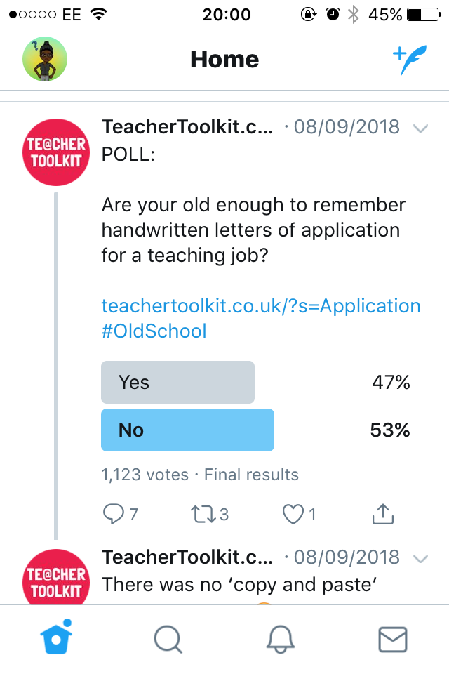
Social media websites: Structure & Features
Bullet points about Polls
Notes:
Twitter enables businesses to create a poll which means a business can……………..
The examples shown are good /poor because….[M1]

Slide 17
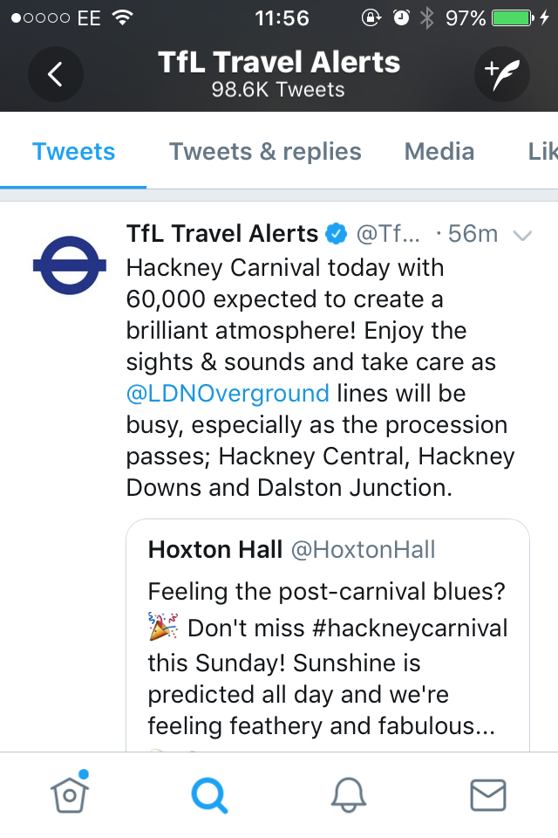
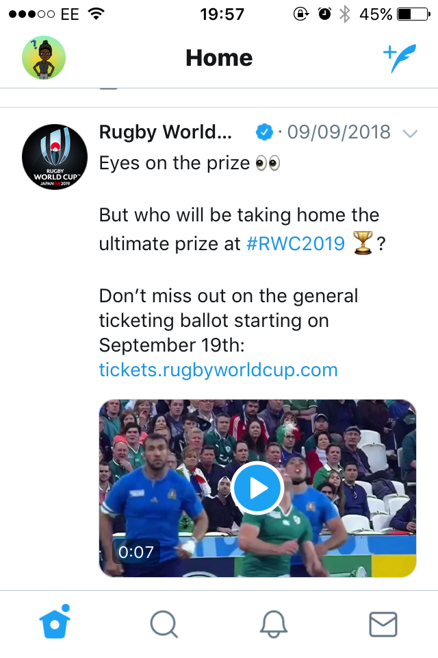
Social media websites: promoting products and/or services
Bullet points about promoting services
Notes:
Businesses can use SM to promote services…………………….
This means that………………………………….
“????????” does this well /doesn’t do this well as……… [M1]

Slide 18
Social media websites: Structure & Features
The use of features, structure and target audience of different social media websites,
For Facebook these include:
Profile
Posts
Likes
Shares
Etc ………..
Notes:
The social media sites have different structures and features that a business can use the first site I will look at is twitter. There are many features that a business can use, they include the following, some of which I will demonstrate…
https://www.lilachbullock.com/twitter-features/

Slide 19
Social media websites: Structure & Features
The use of features, structure and target audience of different social media websites,
For Pinterest these include:
……
……..
……
Etc ………..
Notes:
The social media sites have different structures and features that a business can use the first site I will look at is twitter. There are many features that a business can use, they include the following, some of which I will demonstrate…
https://www.lilachbullock.com/twitter-features/

Slide 20
Social media websites: Structure & Features
The use of features, structure and target audience of different social media websites,
For ……….. these include:
……
……..
……
Etc ……….. [continue for all sites]
Notes:
The social media sites have different structures and features that a business can use the first site I will look at is twitter. There are many features that a business can use, they include the following, some of which I will demonstrate…
https://www.lilachbullock.com/twitter-features/

Slide 21
Social media websites: Supporting Business aims and needs
Businesses can use social media websites to support their business aims and needs by:
o creating an image or brand
o promoting products and/or services
o communicating with customers
o customer service
o resolving queries and managing issues.
Notes:
Every business will have aims that they want to achieve e.g…………………………..
They will have needs such as………
Social media can help to support these by using different approaches………………

Slide 22
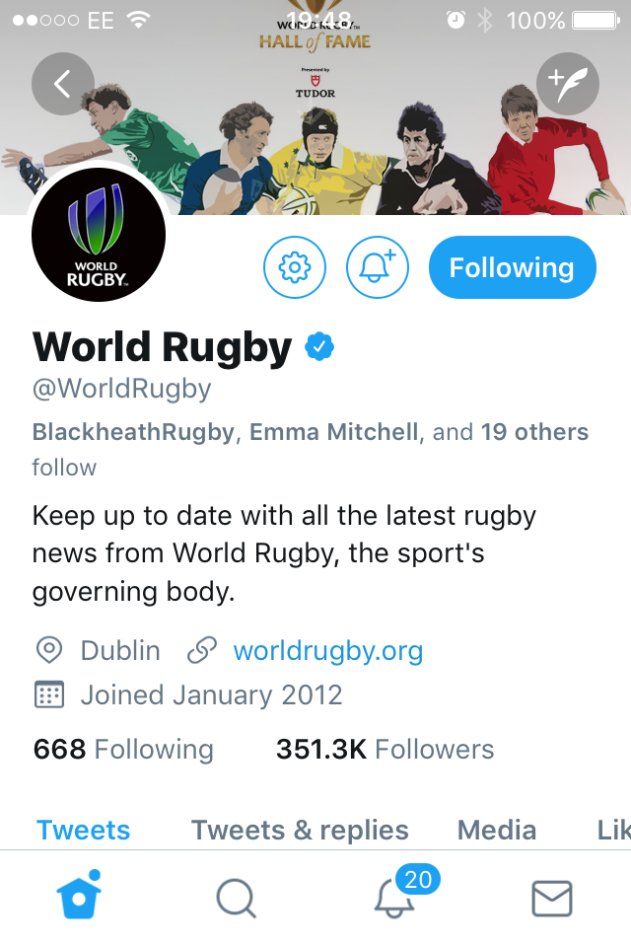
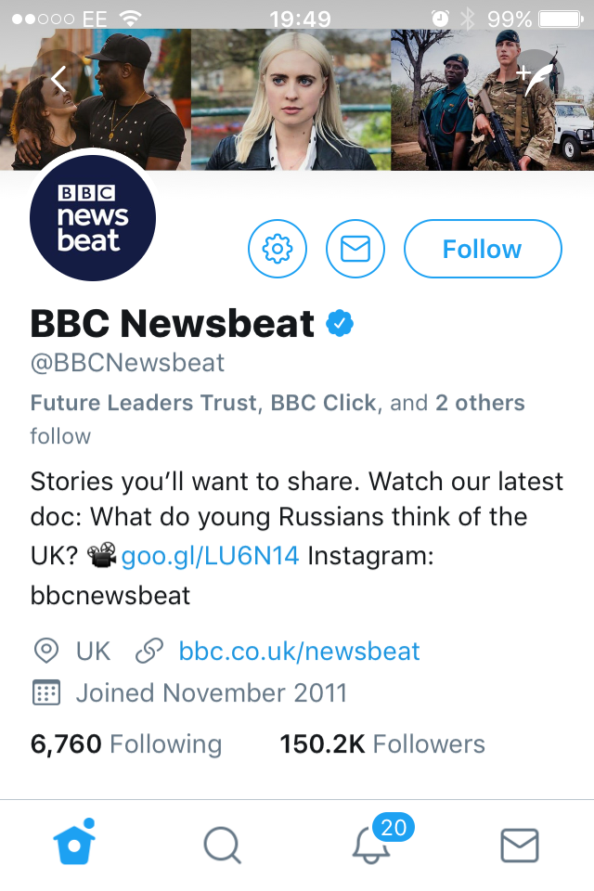
Social media websites: creating an image or brand
Bullet points about the an image /brand
Notes:
Every business will have an image /brand that they want to portray e.g (explaining the difference in the examples given)…………………………..
This is important because…………………………………..
Social media can help to support these by ………………
These do this particularly well because…………

Slide 23
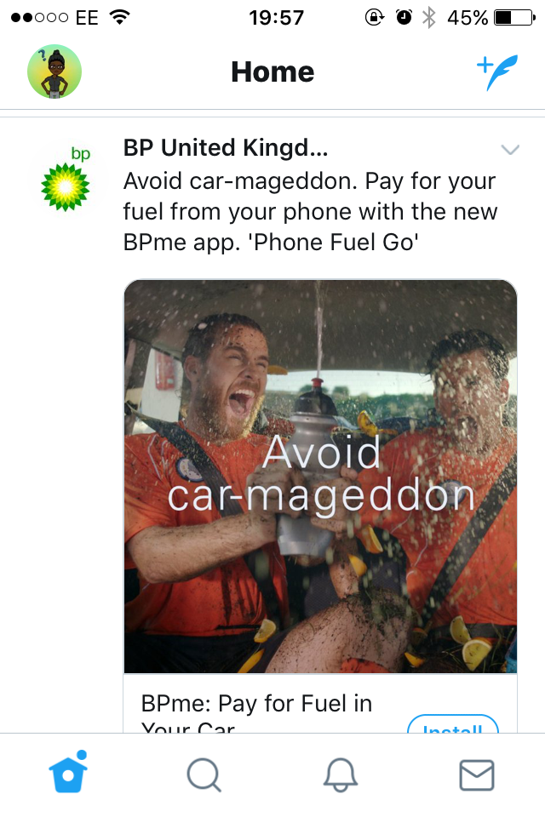
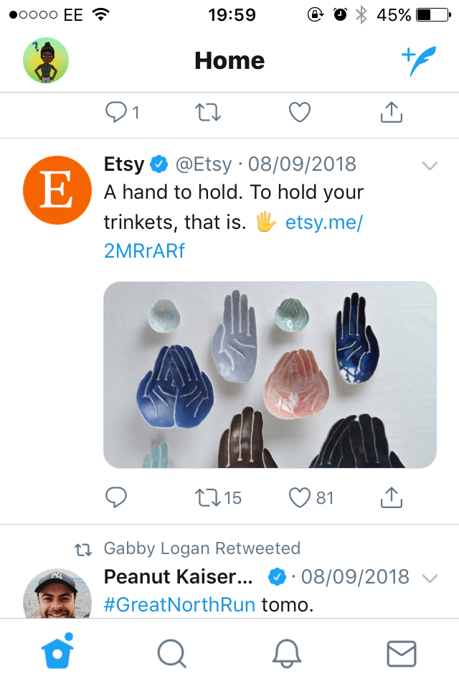
Social media websites: promoting products and/or services
Bullet points about promoting products
Notes:
Businesses can use SM to promote products…………………….
This means that………………………………….
“????????” does this well /doesn’t do this well as………[M1]

Slide 24
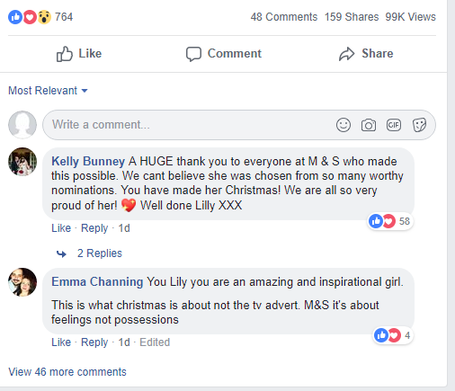
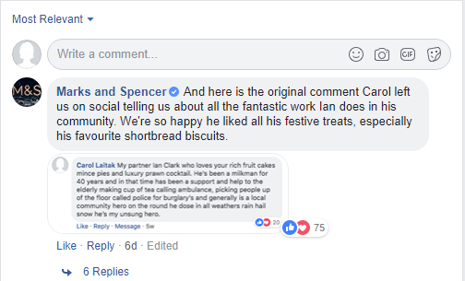
Social media websites: communicating with customers
Bullet points about communicating with customers
Notes:
Businesses can use SM to communicate with customers…………………….
This means that………………………………….
“????????” does this well /doesn’t do this well as………[M1]

Slide 25
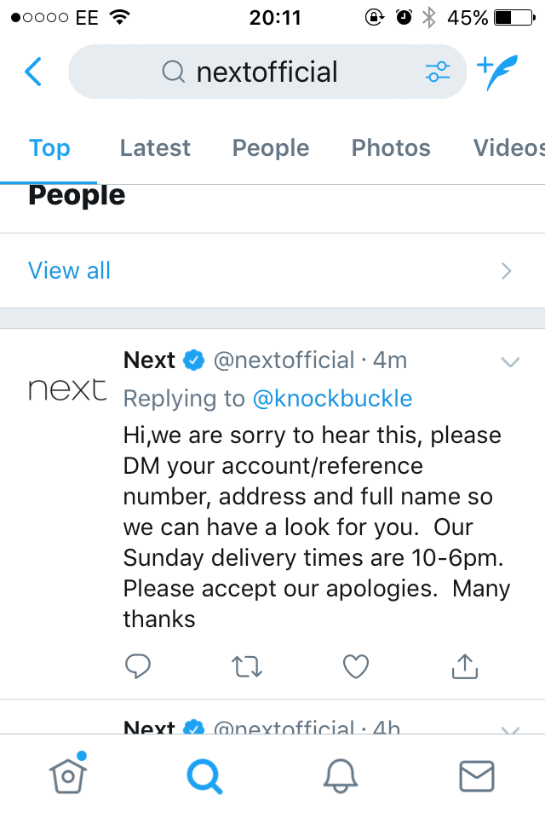
Social media websites: customer service
Bullet points about customer service
Notes:
Businesses can use SM for their customer service…………………….
This means that………………………………….
“????????” does this well /doesn’t do this well as………[M1]

Slide 26
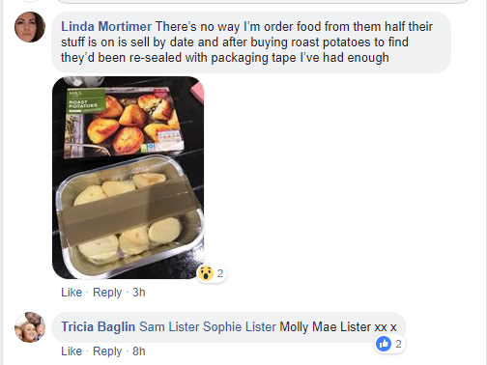
Social media websites: resolving queries and managing issues.
Bullet points about customer service
Notes:
Businesses can use SM to resolve queries and manage issues e.g.…………………….
This means that………………………………….
“????????” does this well /doesn’t do this well as………[M1]

